Slide 1
Supermarket Sales Analysis REPORT
CHINEMEREM EZEJI

Slide 2
Introduction
The objective of this project is to analyze sales data to uncover trends, patterns, and insights that can help improve business strategies. This analysis focuses on various aspects such as sales performance, customer demographics, and product line effectiveness

Slide 3
SALES BY BRANCH AND CITY
City
City Naypyitaw outperformed other cities, with total sales of $110,569
Branch
Branch C showed the highest sales volume, contributing 34% of the total sales.
Branch B had the lowest sales, accounting for only 33% of the total sales.

Slide 4
CUSTOMERS DEMOGRAPHIC
Sales
Sales were almost evenly split between male and female customers, with a slight tilt towards female customers at 52%.
Rating
The gender ratings show that females have a rating of 6.964 while males have a slightly higher rating of 6.981. The minimal difference suggests overall ratings are fairly similar across genders, indicating no significant gender disparity in the measured context.
Customer Type
The data shows 501 members and 499 non-members. This indicates an almost equal split between the two customer types.

Slide 5
PRODUCT LINE PERFORMANCE
Sales
Food & Beverages and Sports & Travel product lines had the highest sales with a combined total of 34% of overall sales.
Rating
The ratings reveal that food has the highest customer satisfaction at 7.1, closely followed by fashion and health, both at 7.0, suggesting these areas are performing well. Electronics, rated at 6.9, falls slightly behind, indicating a potential focus area for quality or customer experience enhancements.

Slide 6
SALES TREND
Sales
In the first quarter, January saw the highest sales at $116,291.87, likely due to post-holiday shopping. Sales dropped to $97,219.37 in February, reflecting the typical retail slowdown and fewer days in the month. March sales rebounded to $109,455.51.
Product Line Trend
Sales of Home & Lifestyle peaked in both March and January, while Food & Beverage saw the highest sales in January and February. There was a notable drop in sales for Home & Lifestyle and Sports & Travel in February, likely reflecting the typical post-holiday decline following the Christmas and New Year celebrations.

Slide 7
PAYMENT METHOD
Sales
The payment method analysis reveals that 35% of transactions were made using e-wallets, making it the most popular choice among customers. Cash transactions accounted for 34%, closely following e-wallets, while credit cards were used in 31% of transactions. This distribution indicates a strong preference for digital payments among customers.

Slide 8
GROSS PROFIT
Profit
The gross profit analysis by unit price reveals that the highest profits were generated from products priced at $90 and above, totalling $5,844.62. Products priced between $60-$70 and $80-$90 followed, with gross profits of $2,957.76 and $2,579.07, respectively. The lowest gross profit came from products priced between $10-$20, which generated only $443.65. This indicates that higher-priced products contribute significantly more to gross profits.

Slide 9
CONCLUSION
The comprehensive analysis of supermarket sales data provides valuable insights into branch and city performance, customer demographics, product line success, sales trends, payment preferences, and gross profit margins.
Branch C emerged as the top-performing branch with 34% of total sales, while Branch B underperformed at 33%. City Naypyitaw led in city-wise performance with sales totaling $110,569.
Gender-based analysis showed an almost even split in sales between male and female customers, with females slightly leading at 52%. Females preferred the Food & Beverages product line, whereas males favoured Health & Beauty.
The Food & Beverages and Sports & Travel product lines dominated sales, accounting for 34% of the total, while Health & Beauty lagged with 15%. Seasonal trends highlighted peak sales for Home & Lifestyle in March and Food & Beverages in February.
In terms of monthly sales, January recorded the highest sales at $116,291.87, likely driven by post-holiday shopping. February saw a dip to $97,219.37, reflecting a typical retail slowdown, but sales rebounded in March to $109,455.51.
Payment methods analysis showed a strong preference for digital transactions, with e-wallets being the most popular at 35%, closely followed by cash at 34%, and credit cards at 31%.
Gross profit analysis indicated that higher-priced products ($90 and above) generated the most profit ($5,844.62). Mid-range products ($60-$70 and $80-$90) also performed well, while the lowest profits came from lower-priced products ($10-$20).
These findings underscore the importance of focusing on high-performing branches and cities, tailoring marketing strategies based on gender preferences, leveraging seasonal trends, promoting digital payment methods, and prioritizing higher-priced product lines to maximize profitability. The detailed findings and visualizations in the Excel dashboard and Google Slides presentation provide further context and support for these insights.

Slide 10
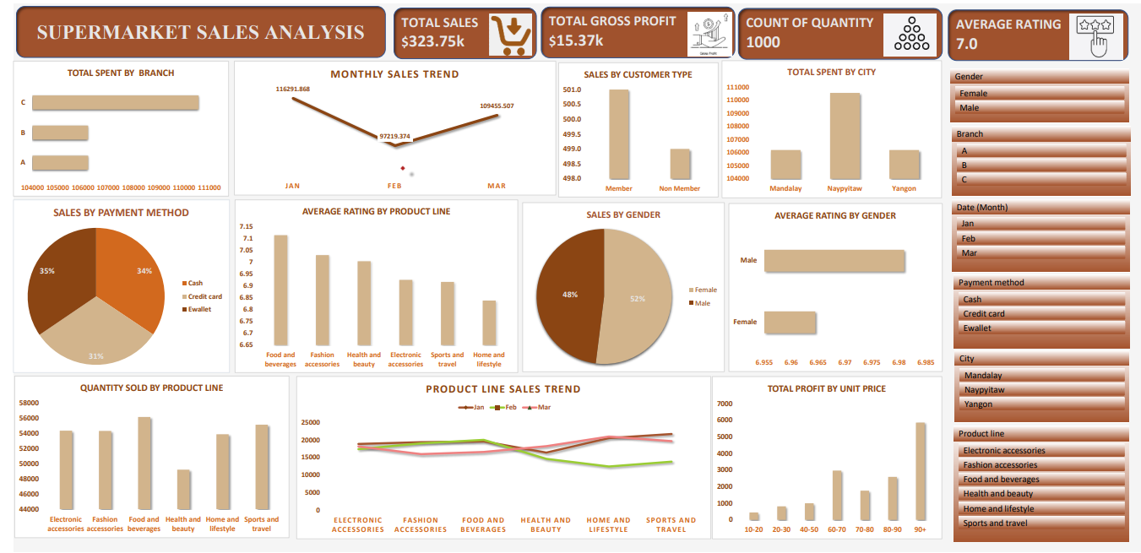
DASHBOARD

